Slide 1

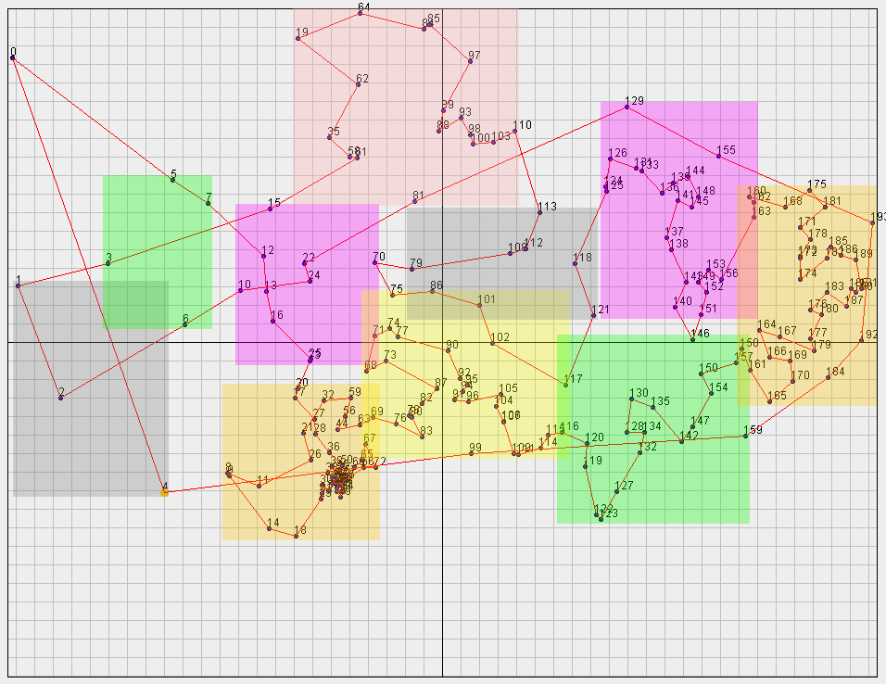
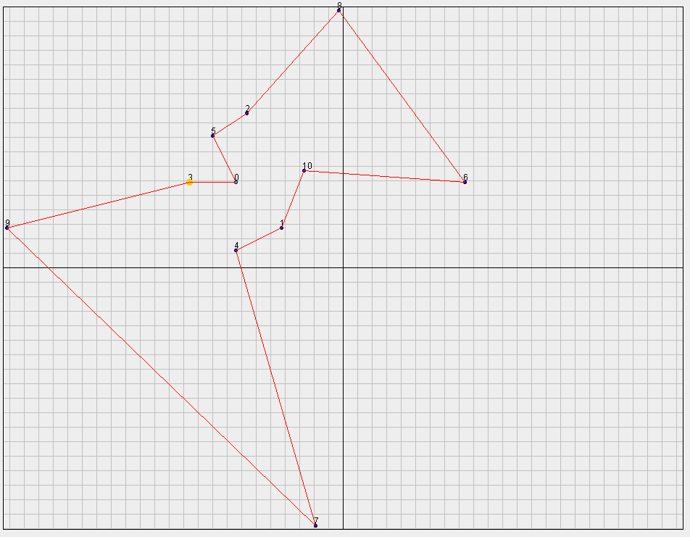
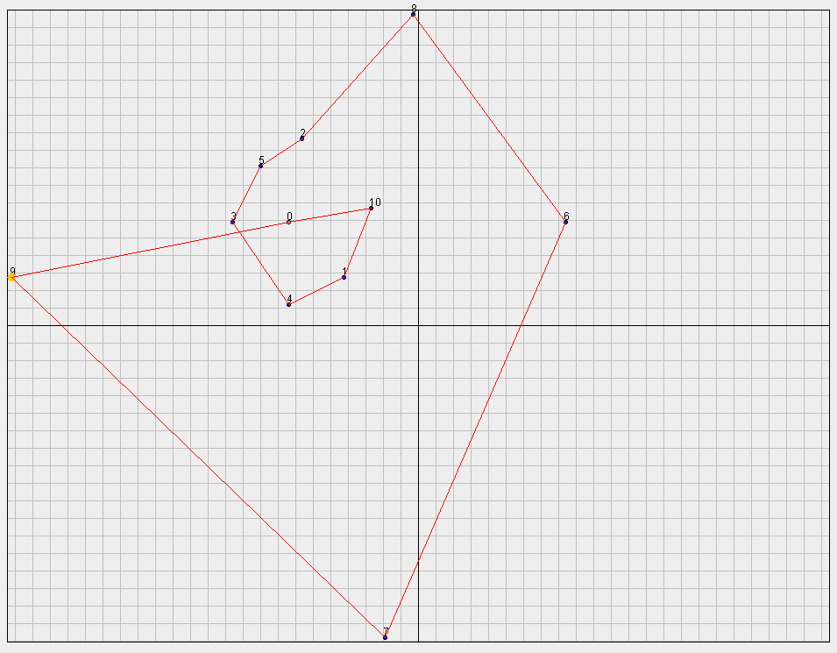
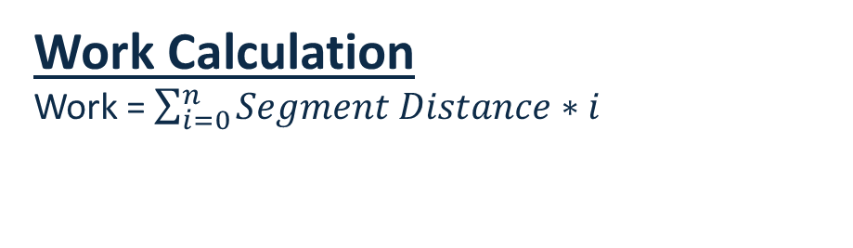
The Tennis Ball Variation of the Traveling Salesman Problem
Tanner Bina and Alec Justice
Department of Computer Science, University of Richmond, VA 23173
Abstract
The Algorithm
Results
The Traveling Salesman Problem attempts to find the shortest tour between a given set of points which visits each point once and returns to the starting point. To use brute force to solve this problem, it is O(N!) efficiency, which quickly becomes computationally infeasible. Therefore, it is often solved using approximation and heuristics.
We looked at a variation of the TSP in which a uniform weight is added at each point which increase the work necessary to visit the next point. This dramatically effects the solving process and heuristics while still being a O(N!) problem.
Over the summer, we designed and implemented an approximation algorithm which calculates a route in O(N³) time. Our algorithm uses clustering to break down sets of points into sets which are small enough to be solved through brute force.
Clustering
Top level clusters are shown by the colored boxes.
Algorithm ran in 1.663 seconds.
The brute force algorithm would take over 7.3E306 steps to complete.
The resulting tour requires 766,119 units of work to complete. The resulting tour is 26% better than the optimal TSP tour.
The goal of our algorithm is to cluster cities into groups of less than ten. Therefore the best route through this sub group can be found through a brute force search.
Our algorithm creates a tree in which every node is a cluster has ten children. Nodes are leaves when they contain less than 10 cities within them.
Our algorithm breaks down a map of cities into 10 clusters; each of those clusters is broken into 10 more clusters and recursively continues until all clusters are below the cutoff point.
Hierarchical K-Mean Clustering
Uses 3-Dimensional clustering based on x position, y position, and distance from other points.
Combines nearest cities into clusters to create 10 original clusters.
Cities are reassigned to nearest cluster centroid until no reassigns are necessary.
During pathing, each cluster is treated as a city based on the mean of its contents’ x and y positions.
Each layer of clusters can then be treated as its own variable weight TBP where the weight of clusters is a function of the number of cities and spread.
The best tour is found using brute force searches in each layer of clusters.
The pathing algorithm assigns numeric values to each node in the tree and its children.
A function then uses these values to create a final tour.
The final tour is optimized using two methods: 2-Opt and Insert-Opt.
2-Opt switches the order of nearby cities to mitigate small mistakes made by the algorithm.
Insert-Opt attempts to insert outliers into different positions in the tour.
Variations between TSP and TBP Routes
Traveling Salesman Tour Tennis Ball Problem Tour
Pathing
Tour | TSP Optimal | TBP Optimal
Distance | 14559 | 15244
Work | 74478 | 59970
Work Calculation
Work = $\sum_{i=0}^{n}{Segment Distance}∗i$
Approximation Efficiency vs. Brute Force
Future Work
Larger city sets are not computationally feasible using brute force searches.
We created an algorithm which approximated a TBP solution in O(N³).
Mathematically analyze data results from multiple city sets to determine how performance of our algorithm varies with different variables.
Improve clustering algorithms.
Determine point map types which are optimally solved using this algorithm.
Allowing for a variable amount of clusters per level of the cluster tree.
Altering the work functions.
Allowing points to exist in multiple clusters to improve likelihood to determine optimal tours.
Optimization
N | N! | N^3
5 | 120 | 125
6 | 720 | 216
7 | 5040 | 343
8 | 40320 | 512
9 | 362880 | 729
10 | 3628800 | 1000
15 | 1.31 * 10^12 | 3375

